Slide 1

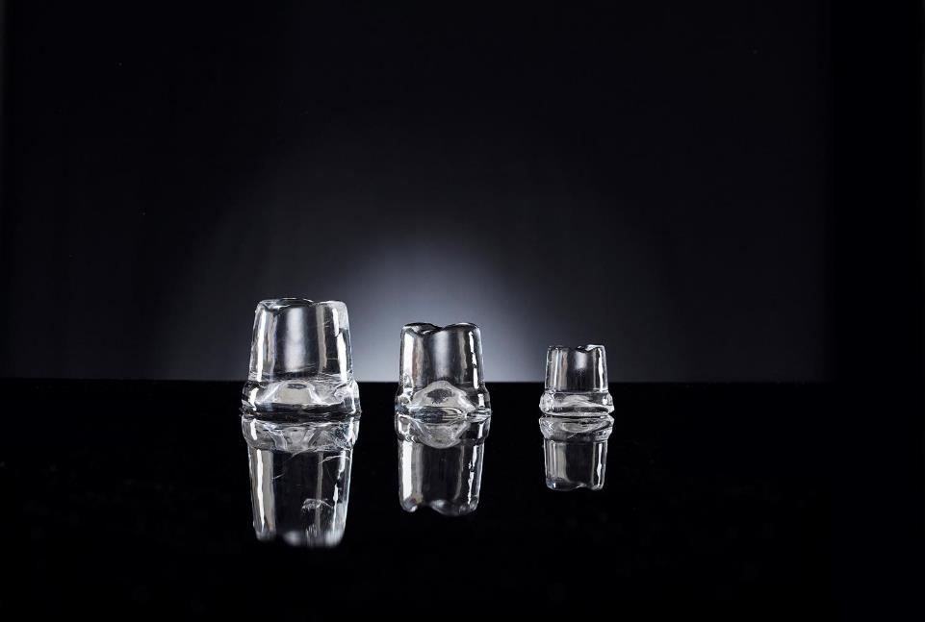

Quick Preview Confidential

Slide 2


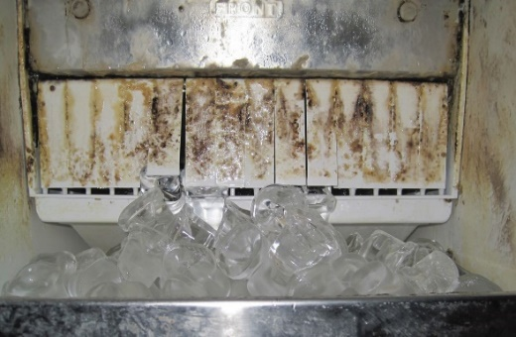
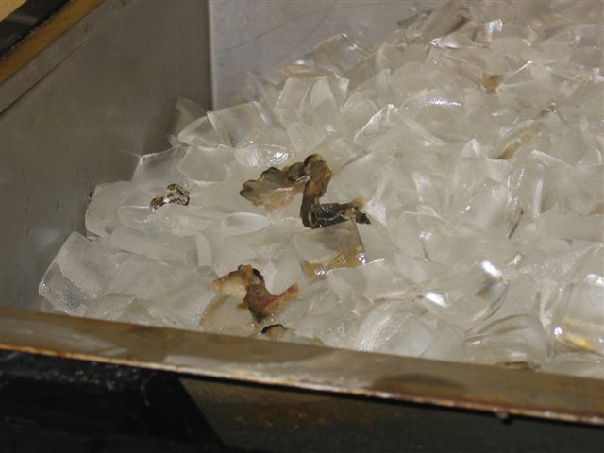
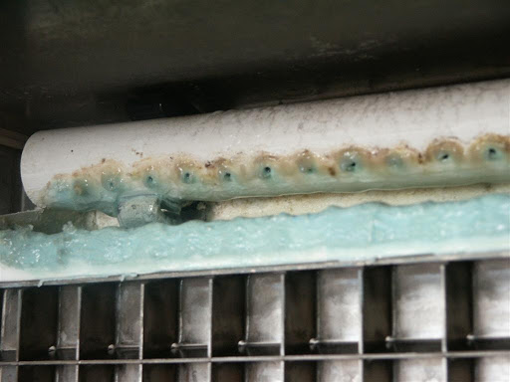
d
Lack of cleaning and better maintenance as well as bacteria and virus proliferation has been always an issue for ice machines. This contributes to ice contamination.
SCOTSMAN is introducing XSafe

Slide 3
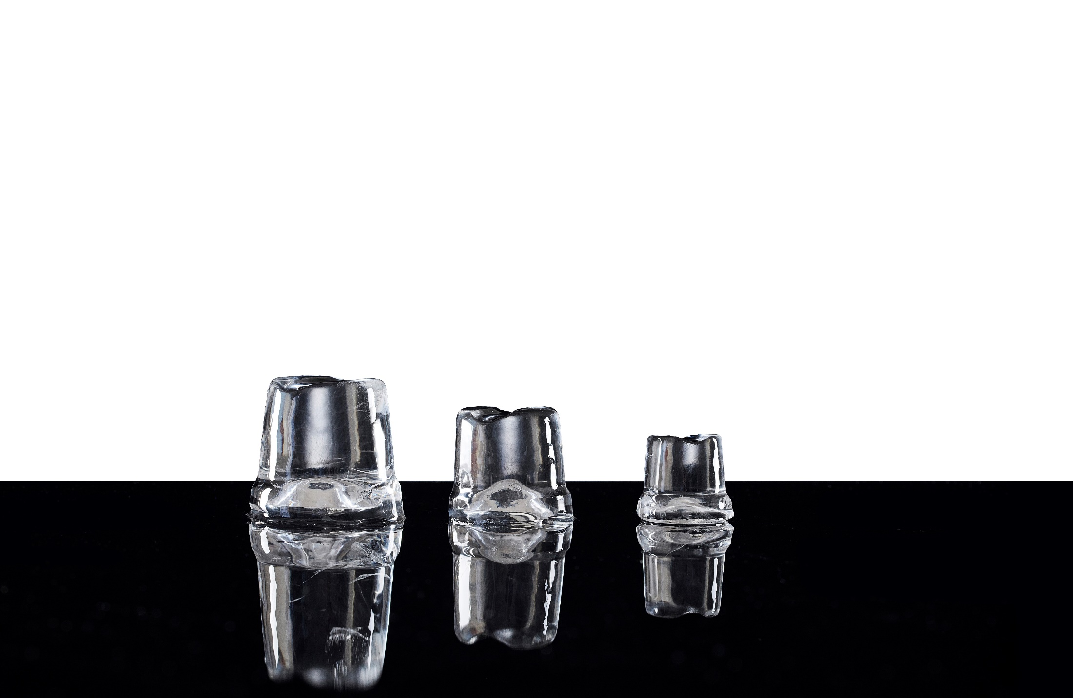
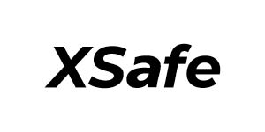
d
is a totally natural cleaning system, integrated inside the ice maker and operating automatically 24/7 to keep equipment clean & safe
It will be developed as follows:
INTEGRATED SOLUTION as a standard in most of the Scotsman models
RETROFIT SOLUTION to be installed as external retrofit in any of the Scotsman ice machines currently installed in the market or held in inventories

Slide 4
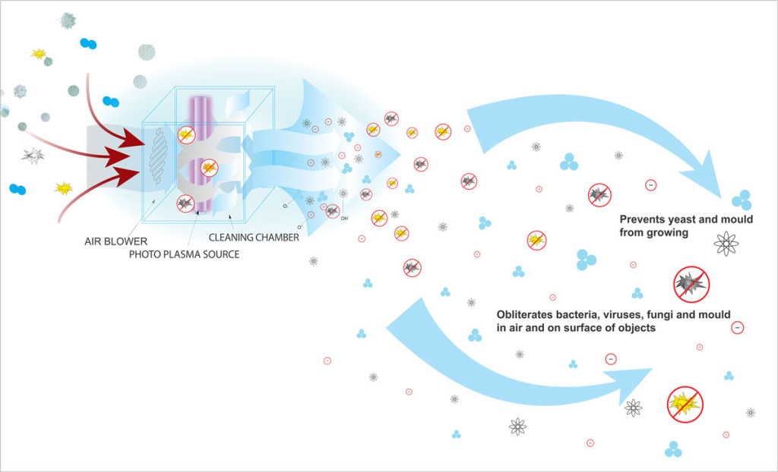
d
Working system Air
XSafe is a natural sanitation system
Replicates positive effects of UV sunlight
Creates a highly-reactive oxygen mixture
Destroy viruses, bacteria and eliminate, mold and slime
XSafe works as a natural and endless cleaning cycle

Slide 5

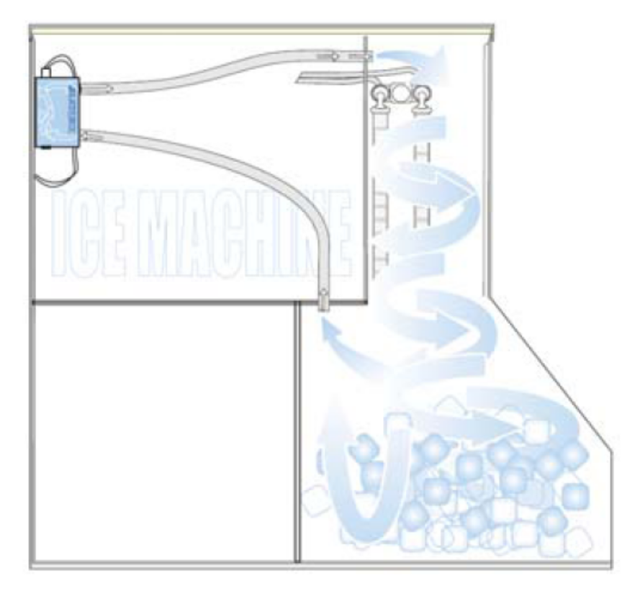
d
Integrated Solution for
Standard in all modular heads (except MAR) and on premium self contained range EC
No need of external plugs or using external space
Small price increase easy to justify with the huge benefits and the savings
Sole company to offer a standard and competitive solution on the after-Covid19 scenario

Slide 6
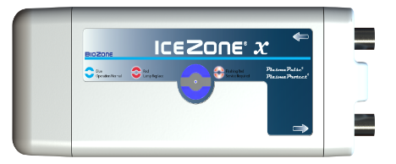
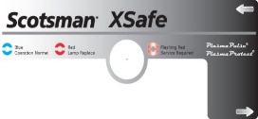
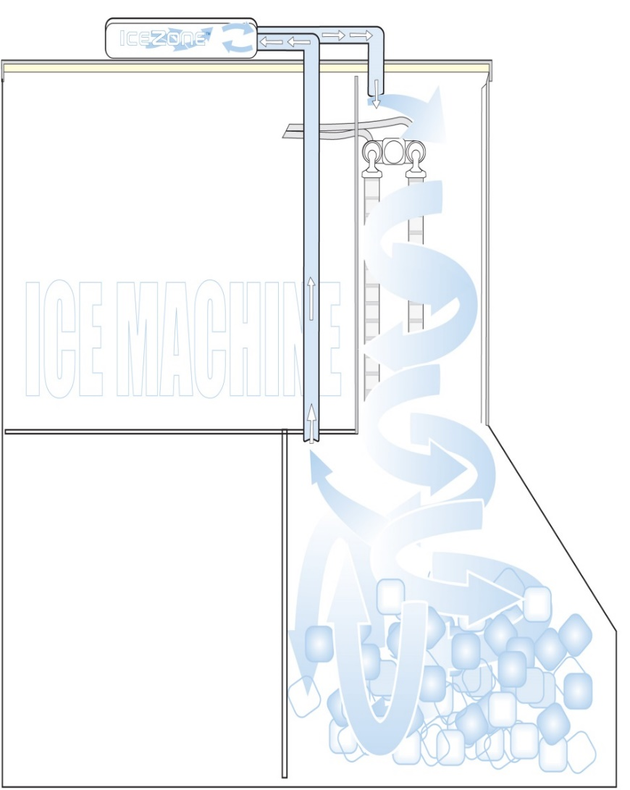
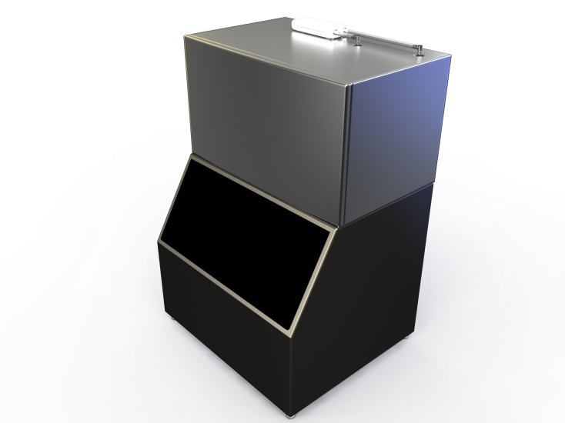
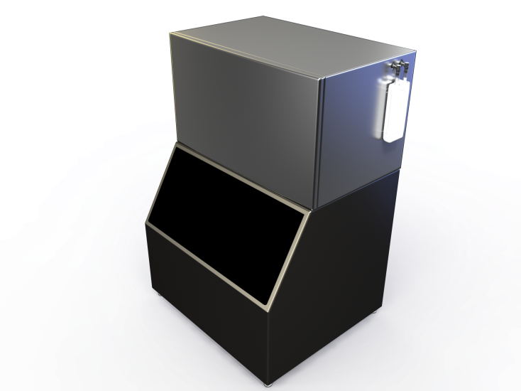
d
Retrofit Solution
Easy to install on existing machines and those that do not have as standard
Premium solution to offer safe ice and total cleaning of ice machine after Covid-19 scenario
Installation Video tutorial available

Slide 7
d
Benefits
Kills viruses and bacteria (99%)
Prevents the formation of slime, mold, and yeast
On average, with XSafe frequency of cleaning the ice makers can be cut by 50%
Increases the lifetime operation of the ice machine by 30%
Completely automated and chemical-free cleaning system
To be launched from September 2020

